Slide 1
Payroll Allocation Confirmation
March 16, 2023
Notes:
Thank you for this opportunity to provide an overview of the new Payroll Allocation Confirmation System that is replacing Effort@. We started on this project in August 2022 meeting with Huron consultants and the many other data stewards across the university to build the necessary data files and configure the system to meet UVA’s requirements. During this process we met with approximately 20 staff volunteers from several schools and departments to test the system and provide feedback. This week we are meeting with faculty volunteer testers to receive their feedback as well. Starting next week and moving into to the following week Huron consultants will begin training Payroll Reporting Coordinators on the new PAC system.
PAC statements will continue to be generated on a semi annual basis.
April 4th 2023, is the date we aiming for go live and this date will start the preview period for payroll reporting coordinators. PRCs will have 15 days to prereview and Faculty will have 30 days to certify. Huron and OSP will be hold office hours for faculty every Wednesday during the certification period should they have any questions or issues with certifying their statements. Additionally, Huron and OSP have been working on a video for faculty to show them step by step how to certify reports in the PAC system. This video will be linked to in several areas in the hopes of making this transition as smooth as possible for faculty.

Slide 2
Federal Guidelines - Documentation for Compensation
Standards for Documentation of Personnel Expenses – Federal Guidelines
Charges to Federal awards for salaries and wages must be based on records that accurately reflect the work performed. These records must:
(i) Be supported by a system of internal control which provides reasonable assurance that the charges are accurate, allowable, and properly allocated;
(ii) Be incorporated into the official records of the non-Federal entity;
(iii) Reasonably reflect the total activity for which the employee is compensated by the non-Federal entity, not exceeding 100% of compensated activities (for IHE, this per the IHE's definition of IBS);
And more…..
Notes:
So why do we have effort@ systems and Payroll Allocation confirmation statements?... The reason is simple and its due to federal guidelines.

Slide 3
Oracle Effort Certification (effort@) - Faculty
Faculty
One Effort Report
Example:
Faculty receives salaries from:
3 federal awards
1 non-federal award
2 institutional accounts
*Clinical faculty, salary sources UVA and UPG
Faculty Effort Report
Section 1.1 - federal award
Section 1.2 - non-fed award
Section 2 - institutional
*Section 3- Medicare cost reporting
Notes:
In Effort@ we have 6 types of reports which encompassed two main category of employees, Faculty and Non faculty-.
Faculty statements were broken out into Non SOM, Non Clinical and Clinical faculty statement types
This slide provides an overview of the Effort @ faculty statement:
Go through example:
A faculty member receives 1 report containing 100% of their institutional base salary

Slide 4
Oracle Effort Certification - Staff, GRAs, Wages
Faculty
One Employee
One Effort Report
Example:
One PI has 7 Grants
that are staffed by:
PI (Self)
15 Grad students
3 Staff
Total: 19 Employees
19 Effort Reports
Notes:
In effort@ non faculty effort reports were broken down into 3 types, GRA, Staff and Wages.
This slide provides an overview of these effort report types in Effort@
Go over example
Every non faculty member had their own effort statement which then had to be certified by the PI of the grants the non faculty member was contributing effort towards.
As a result, a PI would receive a non faculty statement containing 100% IBS
Identify and certify just those grants for which they are they PI
Then repeat the process for each non faculty member contributing effort on their grants

Slide 5
Payroll Allocation Confirmation (PAC) System - PAC Statements (for PI/Faculty) and Grant Statements
Example:
7 Grants staffed by:
PI (Self)
15 Grad students
3 Staff
One Faculty
One PAC Statement
One Grant
One Grant Statement
+
1 PAC Statement
7 Grant Statements
=
8 Total Certification Statements
Notes:
In the new PAC system, faculty statement categories have been reduced from the 3 Non-SOM, Non Clinical and Clinical Faculty types to the singular category of Faculty.
Faculty and PIs will continue to receive one PAC statement containing 100% of their institutional base salary, including an area for Medicare cost reporting for those faculty with Clinical duties
However, instead of PIs receiving statements for each non faculty member working on their grants, they will receive a grant PAC statement containing all the non fauclty salaries being allocated to their grants
Go over example

Slide 6
Email Notifications
Certifiers will be notified:
When the Certification Period Opens (or when the PRC/Grant Managers have completed the Pre-Review)
System Generated Reminder Emails will be sent to certifiers
Notes:
In the PAC system certifiers will continue to receive automated notifications when PAC statements are ready for certification. One difference between the effort@ and the PAC system is the PAC system requires Payroll Reporting Coordinators to go into both statement types to perform preview actions before the statements route to faculty and PIs for certification. In effort@ after the 15-day preview period ended statements automatically routed to for certification. Once the PRC completes their prereview actions in the system the automated notification will issue to the faculty or PI that the statement is ready for certification. This is a change in process and will be a part of PRC training.

Slide 7
Example Notification - Statements are Ready for Certification
PAC Statement Notification
Grant Statement Notification
From: osp-postawardcompliance-request@virginia.edu
To: PAC Statement Certifiers
Subject: PAC Statement is Ready for certification
Your PAC Statement is now available for review and certification in the online Payroll Allocation Confirmation System. PAC statements must be completed to by the due date listed on the PAC Statement. To certify:
Log into the PAC system using this link.
If you are working from the office or logged into VPN, the link will take you by SSO into the Huron PAC System where you will find a worklist of the statements that are ready for certification.
Please work with your Payroll Reporting Coordinator (PRC) if you are unsure if your statement is ready for certification, you receive errors when trying to complete, or if your PAC Statement is on hold.
From: osp-postawardcompliance-request@virginia.edu
To: Grant Statement Certifiers
Subject: PAC Statement is Ready for certification
Your Grant Statement(s) are now available for review and certification in the online Payroll Allocation Confirmation System. Grant statements must be completed by the due date listed on the Grant Statement. To certify:
Log into the PAC system using this link.
If you are working from the office or logged into VPN, the link will take you by SSO into the Huron PAC System where you will find a worklist of the statements that are ready for certification.
Please work with your Payroll Reporting Coordinator (PRC) and/or Grant Manager if you are unsure if your statement is ready for certification, you receive errors when trying to complete, or if your Grant Statement is on hold.
Notes:
Here are some examples of email notifications that will be sent to faculty and PIs when PAC statements are ready for certification. UVA notifications will contain its own language, and this is also one of the places we will be linking the certification tutorial video for faculty and PIs.

Slide 8
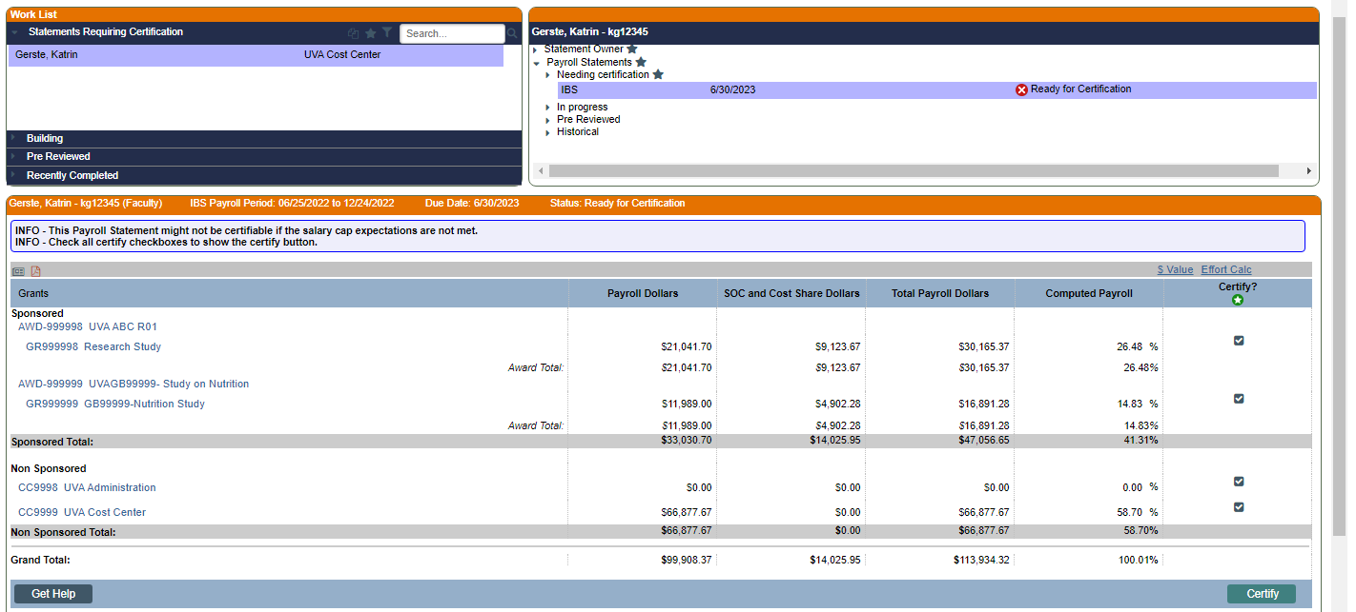
Payroll Allocation Confirmation (PAC) Statement
The PAC Report displays sponsored Grants the employee was charged or cost shared to for the semi- annual period and is a 100% view of a PI/Co-PI/Faculty payroll using the formula:
Computed Payroll = Payroll + Cost Share
The total payroll is shown in dollars and the total payroll percentage is shown for each Grant. This is based on the PI/Co-PI/Faculty total payroll for the semi-annual period.
Notes:
Faculty statement example

Slide 9
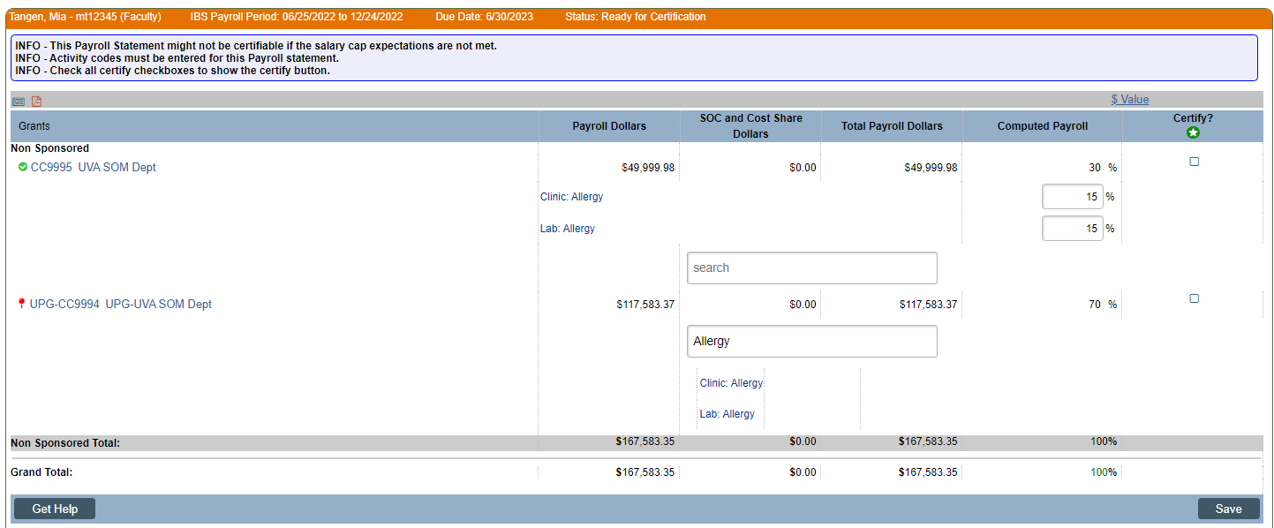
PAC Statement – Medical Center Related Activities Reporting
Medical Center Physicians are responsible for submitting Medical Center Related Activities using their PAC Statement (Section III on the UVA Employee Effort Report in effort@).
Under each Non Sponsored Activity, physicians enter the category and time allotment.
The search field is a lookup search that narrows the search based on the string entered.
The total % for all categories entered under a Non Sponsored Activity must equal the Computed Payroll %.

Slide 10
Grant Statement
Grant Statements display all staff and students who were charged or cost shared to the Grant for the semi-annual period.
Payroll Dollars - The total payroll for each employee charged to the Grant is shown in dollars.
SOC and Cost Share Dollars – Total Salary over the Cap + Cost Share Dollars
Total Payroll Dollars – Total Payroll + Cost Share + Salary over the Cap Dollars
Payroll Percentage - The total payroll percentage is shown for each Grant and is based on the individual's total payroll for the semi-annual period.
PI/Co-PI/Faculty that have charged to a Grant will not be listed on a Grant statement. Their payroll appears on their PAC Statement.
If only PI/Co-PI/Faculty were charged to the Grant, a Grant statement will not be created because the payroll information will be on their own PAC statement.
Notes:
Grant Statement example

Slide 11
Institutional Base Salary Details
Institutional Base Salary information can be found by clicking on the icons in the Details Column:
Dollar Sign – Displays the payroll details allocated to this employee during this reporting period from this grant
Document Icon – Displays the summary of 100% of this employee’s payroll during this reporting period
Notes:
Tools available to see Institutional Base Salary on Grant Statements

Slide 12
PAC System Roles
PAC System Role | Description
Certifier | PI or Faculty that is responsible for certifying PAC or Grant Statements with Sponsored Payroll or Cost Share.
MCR Certifier | Medical Center Physician responsible for reporting Medical Center Related Activities on a PAC Statement.
Primary Payroll Reporting Coordinator (PPRC) | Cost Center Administrator responsible for pre-reviewing PAC and Grant Statements that they are assigned to. Primary PRCs can also add/remove additional PRCs.
Payroll Reporting Coordinator (PRC) | Cost Center Administrator responsible for pre-reviewing PAC and Grant Statements that they are assigned to.
Central Administrator | Administrator group that manages the overall PAC System
MCR Administrator | Administrator group that manages Medical Center Reporting
Proxy | PI or Faculty that is responsible for certifying PAC Statements with Sponsored Payroll or Cost Share on behalf of another PI or Faculty
Designee | PI or Faculty that is responsible for certifying Grant Statements with Sponsored Payroll or Cost Share on behalf of another PI or Faculty

Slide 13
Q&A
Questions?
If you have questions after the presentation, please contact Post Award Compliance by email at osp-postawardcompliance-request@virginia.edu

