Slide 1
Navigating ResearchUVA Powered by Huron (PBH) for OSP
MaryBeth Spaulding
Office of Sponsored Programs

Slide 2
Today’s Agenda
Introduction
Terminology and Navigation
Awards and Award Modifications
Demonstration

Slide 3
What is Changing? What is Staying the Same?
What is Changing?
New proposals and agreements will be created in ResearchUVA PBH starting on 4/25
Some compliance reviews will occur directly in the system (via Ancillary Review)
Share and track correspondence in the system (vs. emails)
What is Staying the Same?
For the immediate future, legacy ResearchUVA will be available for the field for actions related to established projects (award modifications, post-award actions, supplemental proposals)
OSP will continue to be able to complete in-progress actions in legacy ResearchUVA after ResearchUVA PBH go-live and through WD go-live (July)

Slide 4
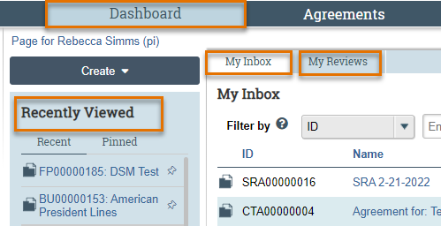
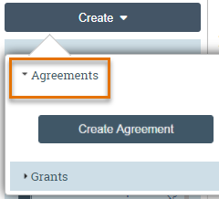
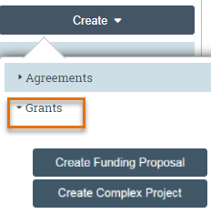
Terminology and Navigation
Navigating in ResearchUVA PBH
From your Dashboard:
My Inbox: Items that require you to take action.
My Reviews: Items assigned to you to review. These are a subset of the items in My Inbox.
Create menu and buttons: Create actions you can perform.
Recently Viewed: The last several items you viewed. Look here for an item you worked on recently.

Slide 5
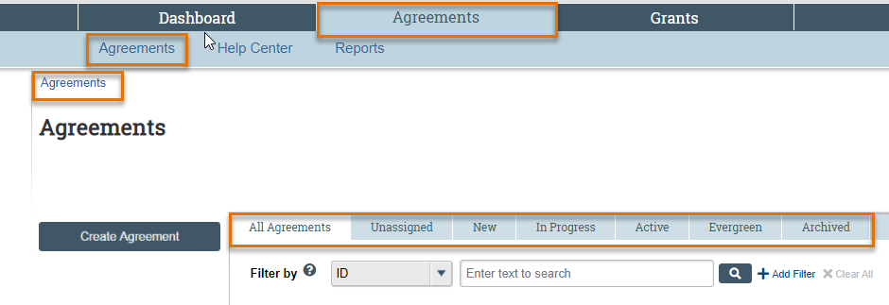
Terminology and Navigation
Navigating in ResearchUVA PBH
To find a specific Proposal, Award or Agreement, you can navigate to all of your records and then sort by one or more criterion
A “breadcrumb” trail is in the top left corner

Slide 6
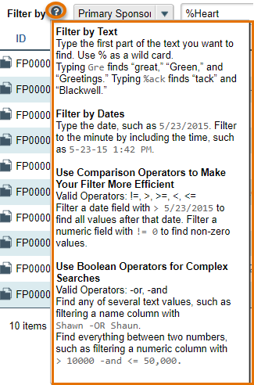
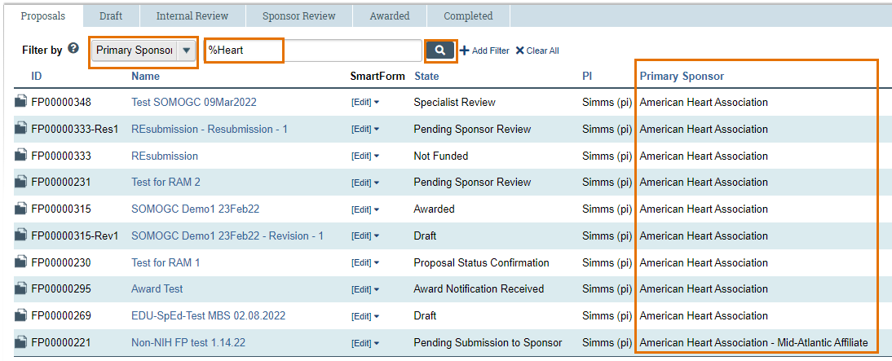
Terminology and Navigation
Using the Search Feature to Filter Data
This screenshot features a “wildcard” search for the word “heart” to find proposals to the American Heart Association
To complete this search, select “Primary Sponsor” in the search drop-down, type “%heart” and then click the search icon to complete the search
This screenshot provides an overview of the available search filters. You can always find these options by clicking the help text icon (question mark)

Slide 7
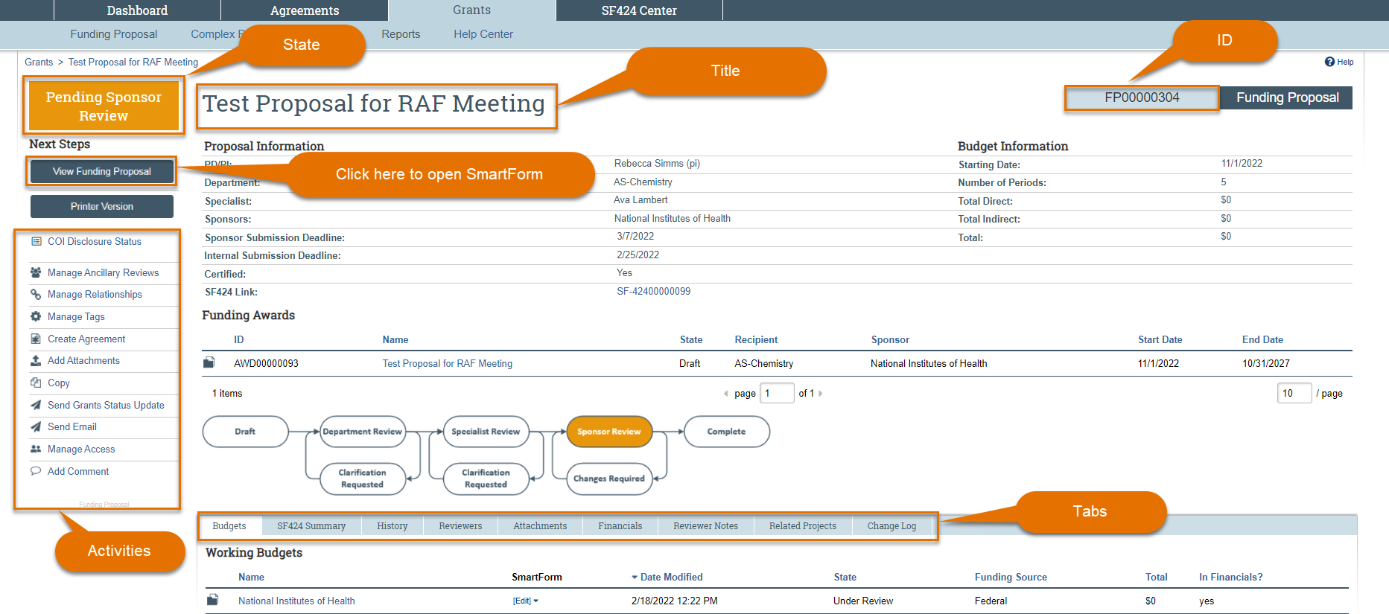
Terminology and Navigation
Workspace

Slide 8
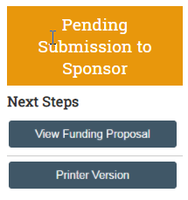
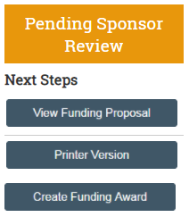
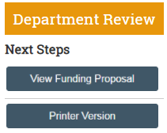
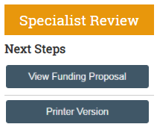
Terminology and Navigation
Accessing the SmartForm from the Workspace
Notes:
The workspace can be accessed in all stages – it will be editable or view only depending on the state and a user role + the individuals role on the project

Slide 9
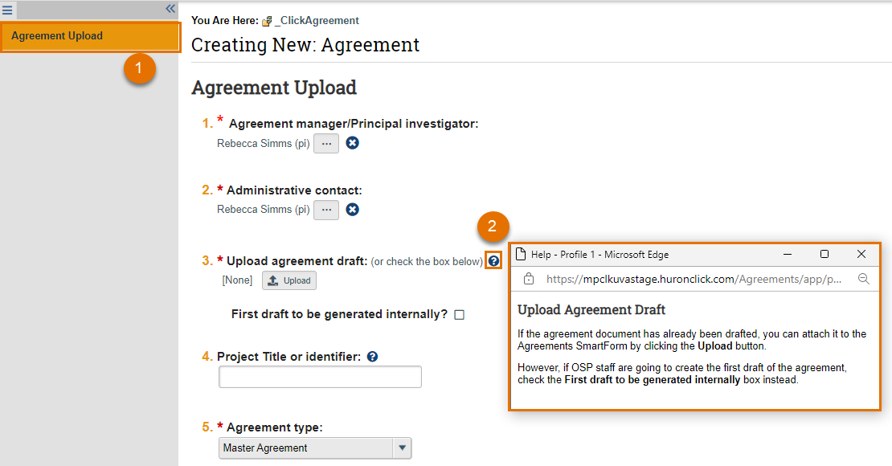
Terminology and Navigation
Using the SmartForm
1. The remaining SmartForm pages will fill in after you complete and save the General Information page
2. Clicking on the help text icon (question mark) will bring up a help text pop-up window containing UVA instructions for that question

Slide 10
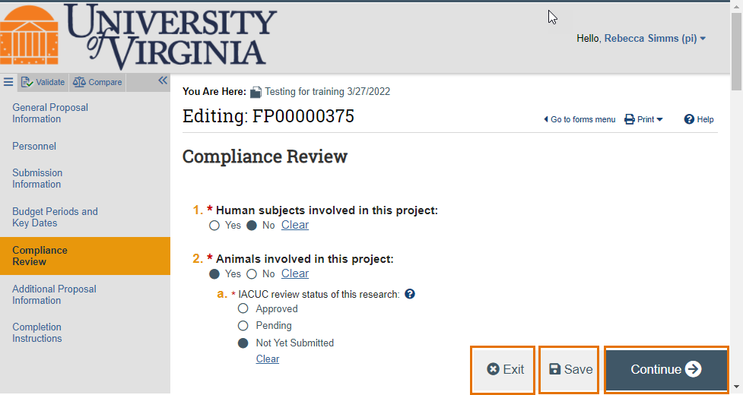
Terminology and Navigation
Using the SmartForm
SmartForm pages will have 3 “buttons” at the bottom: Exit, Save and Continue (Continue is replaced with Finish on the final form)
Exit returns to the Workspace
Save saves the page
Continue saves the page & moves to next page
Finish saves & returns to the Workspace

Slide 11
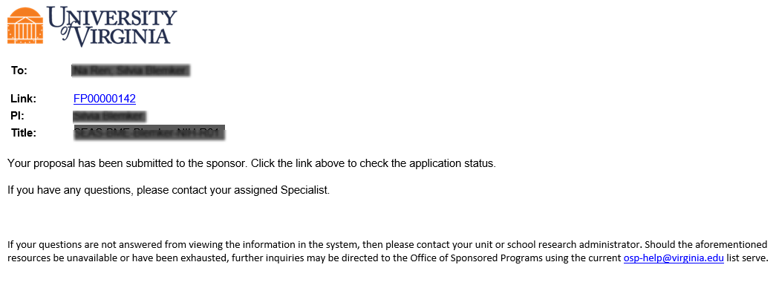
Notifications
System Notifications
System notifications are short email messages sent by the system to alert a users an action in the system – notifications often ask the user to take an action to move a project forward in workflow
Notifications contain a link that will take users to the project that requires their action or attention. Users can also navigate directly to a project using the Dashboard or Grants/Agreements module pages

Slide 12
Workflows
Proposal
Award
Agreement

Slide 13
Demonstration
Navigation
Finding Sponsor NOA
Award Mods (Budget Bumps)
Follow along at: https://mpclkuvastage.huronclick.com/GrantsTest
Notes:
UVA-119 – Final review NIH unilateral
UVA-115 – Draft award, cost share and bilateral agreement (SRA-27)
UVA00000120-MOD001 – Budget Bump
AWD-87 – Active award with active bilateral agreement (SRA-18) FP410 – Cost Share NIH Budget

Slide 14
Thank you
https://research.virginia.edu/osp

