Slide 1
ResearchUVA Powered by Huron (PBH)
Training Series
Create and Submit a Proposal: Basics (Part 1)

Slide 2
Agenda
Welcome and Training Tips
Resources and Support
Funding Proposal Overview
Funding Proposal Demonstration
Hands-On Exercise
Wrap-Up
Notes:
Alex Presenting

Slide 3
Instructor Introduction and Welcome
Cecelia Cropley
Alex Torres
Department of Chemistry, College of Arts and Sciences
Department of Pediatrics, School of Medicine
Our favorite feature of the funding proposal smart form: ability to add collaborators, including faculty and research administrators.

Slide 4
Training Tips
Mute / Unmute
Video
Questions
Breakout rooms for live exercise
Notes:
Use Mute
Video not required for participants
Questions in chat

Slide 5
Resources and Support
ResearchUVA PBH Website:
https://research.virginia.edu/osp
Support Materials
Reference guides, job aids, checklists, videos
Instructor-led Training Sessions
Zoom (virtual) Office Hours
M-F during business hours April 25th – May 6th
Office hours continue the week of May 9th, schedule will be posted on website
Submitting school representatives will attend office hours
Helpdesk Support
ruva-huron-help@virginia.edu
Notes:
A version of this training session will be recorded and posted to the website by go-live (April 25th)
Immediate feedback for something you are working on in office hours (bring live cases we can help you with)
Helpdesk will provide support for technical issues

Slide 6
What is Changing? What is Staying the Same?
What is Changing?
Build, submit, and manage federal proposals in the same system
Some compliance reviews will occur directly in the system (via Ancillary Review)
Share and track correspondence in the system (vs. emails)
Linkage between related funding proposals, awards, and agreements
What is Staying the Same?
Sponsor and UVA requirements around sponsored grants and contracts
Non-system to system proposals are submitted as they are today
Complex proposals still submitted via Workspace or ASSIST (for NIH)
Support from OSP and Submitting School Pre-Award Offices
Notes:
Cecelia Presenting

Slide 7
Session Objectives
Navigate ResearchUVA PBH Funding Proposals
Create and Submit a Funding Proposal
Locate information in a Funding Proposal Workspace
Understand and Use Funding Proposal Activities
Notes:
Cecelia Presenting
Talking point – this is session 1 of 3. Attendees need to do them all. This information is similar to the ePRF without the budget
Part 1: Create and Submit a Proposal: Basics
Part 2: Create and Submit a Proposal: Budget Development
Part 3: Create and Submit a Proposal: Grants.gov Proposals and the SF-424 (optional for those submitting S2S)

Slide 8
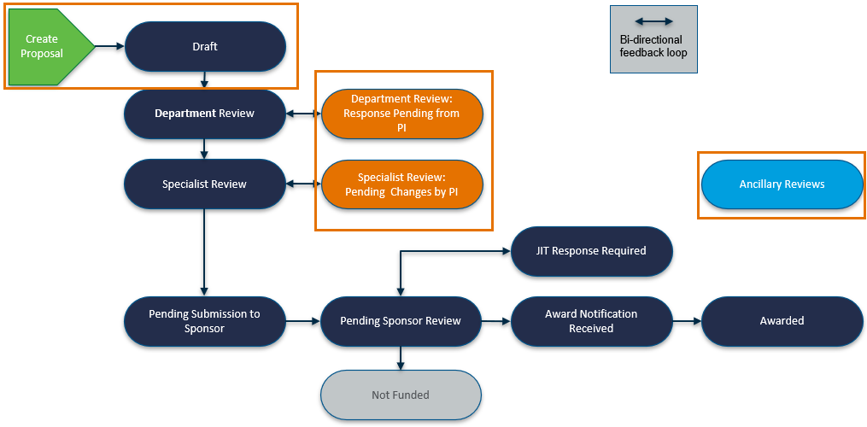
Funding Proposal Workflow
Notes:
Cecelia Presenting
Spend time explaining the workflow – areas in orange are what we will discuss today – prepare & submit and ancillary reviews

Slide 9
Navigation Overview – Live Demonstration
Dashboard
My Inbox: Items that require you to take an action.
My Reviews: Subset of items in My Inbox that are assigned to you to review (this tab is most applicable to users with a reviewer role).
“Create” menu and buttons: Action you may be able to perform. The menu will not show if you do not have access to any “create” buttons.
Grants Module Page
Shows all the records you have permission to see.
Workspace
State, Workflow Map, Activities, Workspace Tabs
SmartForms
Form that captures funding proposal information.
Notes:
Alex Presenting
The Dashboard is the “Grand Central Terminal” for all of the proposals and awards that are in progress, and it will be the first thing you see once you’ve logged in.
This a preview of what we will navigate

Slide 10
Funding Proposal – Live Demonstration
Create a Funding Proposal
Review Activities: Use Send Email Activity
Send email is a way to send messages through the system.
Review PI Certification Process
For multiple PD/PI proposals, the “contact PD/PI” will certify via the PI Certification Activity. All other PIs will certify via Ancillary review.
Create Ancillary Review
Review created to capture ad hoc approvals concurrent with the funding proposal workflow.
Submit Funding Proposal to Department Review
Department review is the first step in the workflow after the PI submits a proposal.
Respond to Clarifications from Department or Specialist Review*
This is how the PI or designee will respond to review comments. *Today’s hands-on exercise will not include this step, but we will demonstrate how to respond to a review.
Notes:
Alex Presenting
We will demonstrate a foundation. The exercise will cover a S2S submission – that will allow the FP to be copied and used in session 2 & 3
The hands-on exercise will use a training PI as the PI and attendees will be listed as the administrative contact – if we have any PIs in today’s training, you are welcome to leave yourself as the PI of the funding proposal when we get to the hands-on portion of today’s training. Note that attendees will not be able to complete the PI Certify process because you will not be the PI. However, we will demonstrate it today so you can see what it looks like for the PIs you work with.

Slide 11
Today’s Hands-on Exercise
Create a funding proposal
Short title = include today’s date and your initials
20220405 MAS
Sponsor = National Institutes of Health
FOA = PA-FO-R01
Complete and save the funding proposal SmartForm
Return to the proposal Workspace
Create an Ancillary Review (Manage Ancillary Review activity)
Practice Using Other Activities
Submit proposal for department review (Submit for Department Review activity)
Notes:
This is for training purposes only. You would normally complete the budget & SF424 BEFORE submitting but we want to demonstrate the Submit activity to show you how the state transitions and the FP is no longer editable.

Slide 12
Thank you for joining today!
Be sure to join upcoming training sessions for Funding Proposal Budgets, System-to-System Submissions, Awards, and Agreements.

Slide 13
Questions?
ruva-huron-help@virginia.edu

