Slide 1
ResearchUVA Powered by Huron (PBH)
Training Series
Create and Submit a Proposal: Budget Development (Part 2)

Slide 2
Instructor Introduction and Welcome
Catherine Thompson
Pre-Award Research Administrator, School of Education and Human Development
cet4n@virginia.edu
Angela Behrend
Senior Grants & Contracts Administrator, OSP
ags3f@virginia.edu

Slide 3
Agenda
Welcome and Training Tips
Resources and Support
Funding Proposal Budget Overview
Budget Development Demonstration
Hands-On Exercise
Wrap-Up

Slide 4
Training Tips
Mute / Unmute
Video
Questions
Breakout rooms for live exercise
Notes:
Use mute
Video off
Questions in chat

Slide 5
Resources and Support
ResearchUVA PBH Website:
https://research.virginia.edu/osp
Support Materials
Reference guides, job aids, checklists, videos
Instructor-led Training Sessions
Zoom (virtual) Office Hours
M-F during business hours April 25th – May 6th
Office hours continue the week of May 9th, schedule will be posted on website
Submitting school representatives will attend office hours
Helpdesk Support
ruva-huron-help@virginia.edu
Notes:
A version of this training session will be recorded and posted to the website by go-live (April 25th)
Immediate feedback for something you are working on in office hours (bring live cases we can help you with)
Helpdesk will provide support for technical issues

Slide 6
What is Changing? What is Staying the Same?
What is Staying the Same?
Sponsor and UVA requirements around sponsored grant and contract budget development and approvals
UVA F&A and fringe benefit rates
Support from OSP and Submitting School Pre-Award Offices
What is Changing?
Create budgets in the proposal system Prepare multiple budgets that roll into one budget in the system
Designate whether a budget is to be submitted to a sponsor or will be used for internal purposes (i.e., cost share budget)
Budget exception approvals are captured in the system (via Ancillary Review)

Slide 7
Session Objectives
Learn How To::
Create and modify budgets
Navigate Between the Funding Proposal Workspace and the Budget Workspace
Manage various types of Budgets (Federal, Non-Federal, Internal, Subawards, Cost share)
Notes:
Federal, non/federal, subawards, cost share, SF424 budgets

Slide 8
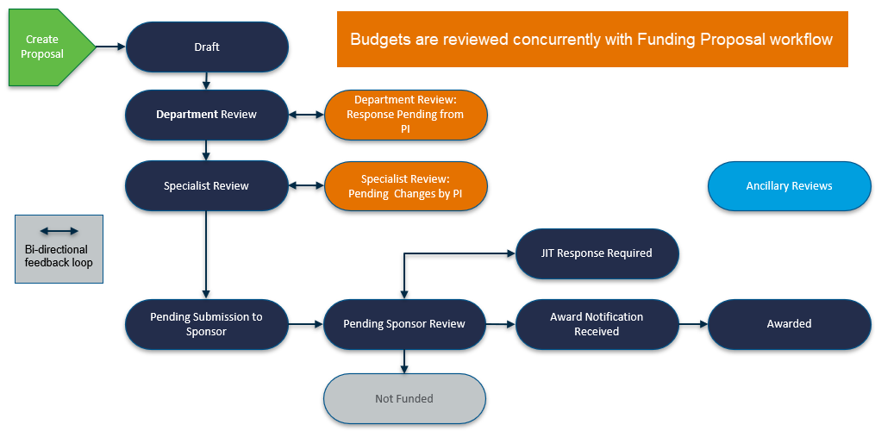
Funding Proposal Workflow
Notes:
Talking points:
Schools may have differences in how proposals are routed, could be more than one level of department review
Ancillary reviews are concurrent with workflow
Budgets are created and reviewed along with the funding proposal
For S2S submissions, the budget is step 2 and one of 3 components for a successful submission.
Step 1: Create FP
Step 2: Update proposal budget & create additional budgets (if needed)
Step 3 (if applicable): Create SF424, covered in a separate session

Slide 9
Funding Proposal Budgets – Live Demonstration
Creating a Funding Proposal Sponsor Budget
The Funding Proposal will automatically have one sponsor budget
Three types of budgets can be created on a Funding Proposal:
Sponsor
Cost Sharing
Subaward
Updating the Funding Proposal Sponsor Budget
Creating and completing a Subaward Budget
Review a Cost Sharing Budget*
Review Exporting a Subaward Budget to a Grants.gov PDF*
If the UVA Funding Proposal is an incoming subaward through another institution, the system can generate the required Grants.gov budget form.
* Demonstration only. These will not be part of today’s hands-on exercise.
Notes:
Remind attendees they can reach out to their school for help if they need assistance with budgets
Talking point: NIH vs. non-NIH budgets. Non SF424 budgets

Slide 10
Today’s Hands-on Exercise
Copy a funding proposal from the Funding Proposal Overview session
New proposal name = include today’s date, your initials, and “budget session”
20220405 MAS Budget session
If you do not have a funding proposal handy, you may copy FP00000236 “RUVA PBH Budget Demo#1 COPY for DEMO
Navigate to the new Funding Proposal and click on the Budgets tab
Open and complete the Proposal Budget
Create, open, and complete a Subaward Budget
Return to the Funding Proposal Workspace, review Budgets tab
Notes:
Demonstrate how to copy a proposal and rename it

Slide 11
Thank you for joining today!
Be sure to join upcoming training sessions for System-to-System Submissions, Awards, and Agreements.

Slide 12
Questions?
ruva-huron-help@virginia.edu

